Slide 1
The Extreems
RTU HACKATHON 2018
Group Leader :=Tanmaya Chaudhary
Vipin Gupta
Mukul Sharma
Swapnil Bhatia
Institute of Engineering and Technology, Alwar

Slide 2
Irrigation
Irrigation is the application of controlled amounts of water to plants at needed intervals. Irrigation helps to grow agricultural crops, maintain landscapes, and re-vegetate disturbed soils in dry areas and during periods of less than average rainfall.

Slide 3

Problem
Closed loop irrigation solution for farmers:
Irrigating fields plays a vital role in crop yield. However, how much and when to irrigate is still moderated by the traditional knowledge for the farmers. Knowing how much water is actually required for a given crop for a particular soil type depends majorly on soil’s capacity to hold moisture. We need an IoT, AI based solution which can auto irrigate the fields for a given crop based on the soil moisture content.

Slide 4


Slide 5
Smart irrigation with IOT
Smart irrigation, which enables more precise and efficient use of water and energy, offers the most viable option for water conservancy, along with reduction of operating costs for farming, while significantly improving industrial, commercial, and residential watering processes.
We use IOT and AI system because now a days every one wants to less work. We have Sprinkler and many other instrument but all are manual and we have no it is not secure like if today we irrigate but next day may be rain then our irrigation is waste.

Slide 6
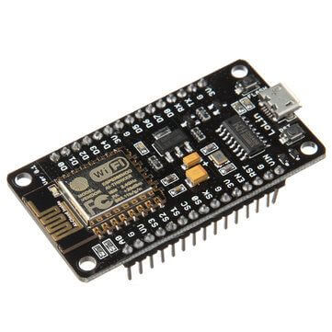
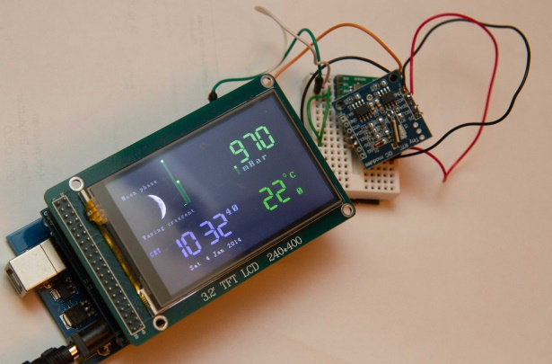
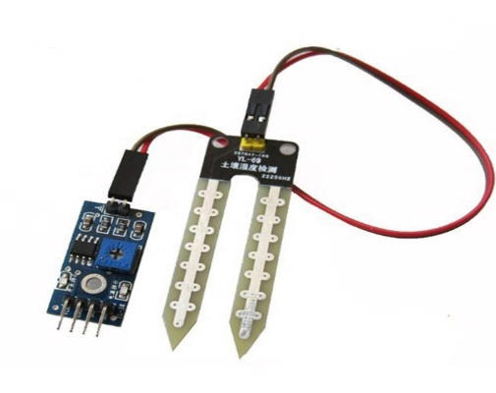
Component
S No | Component | Quantity
1 | ESP8266 | 1
2 | Moisture Sensor | 1
3 | Weather Station | 1

Slide 7
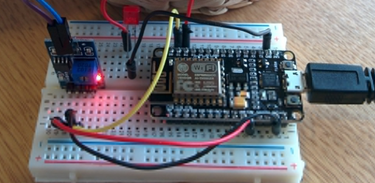
Design

Slide 8
How it works???
Well! First of all it has two condition
If moisture value is less than threshold value & the probability for rain for next 4-5 days is less then 60-70% then irrigation process will be perform.
If moisture value is more then the desired value then irrigation process will be stop.

Slide 9
Challenge - 1
How we represent the product that the farmers are able to understand the product benefits for them?
Solution
* LOW COST
* No Hard work only smart work
* Less work more profit
* Decrease waste of water and better crop.

Slide 10
Challenge – 2
If some sensor will not working properly after some time then how to know that which sensor are working properly or not?
Solution
Every sensor have individual value. We set a system which tell us about the current position and working state by the help of LED blinking

Slide 11
Challenge - 3
Where we drop the sensor in the firm so that it will not broken by the tractor during cultivating?
Solution
* We placed sensor at corners and one or two sensor in the middle of Firm
* We insert the sensor just after the Plow because in the time of Plow sensor may be broke

Slide 12


